Slide 1
Analysis of 25,000 Lab-Confirmed COVID-19 Cases in Wuhan: Epidemiological Characteristics and Non-Pharmaceutical Intervention Effects
Xihong Lin
Department of Biostatistics
School of Public Health and Department of Statistics
Faculty of Arts and Sciences
Harvard University
and Broad Institute of Harvard and MIT

Slide 2
Huge Thanks to Our Staff
HSPH Biostat: Amanda King, Elizabeth Solinga
HSPH IT: Shawn DeAntonio, Katherine Targett
HUIT: Maria Apse, Scott Yockel

Slide 3
Participants are welcome to comment and ask questions using Zoom chat

Slide 4
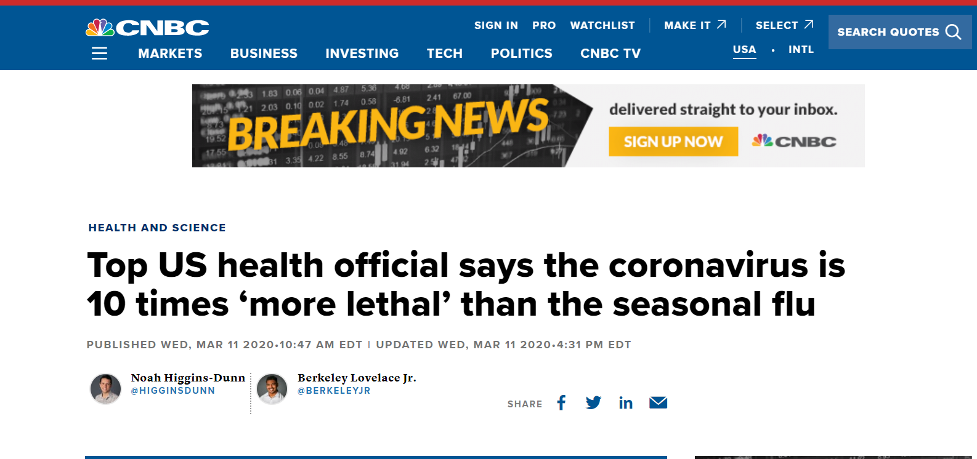
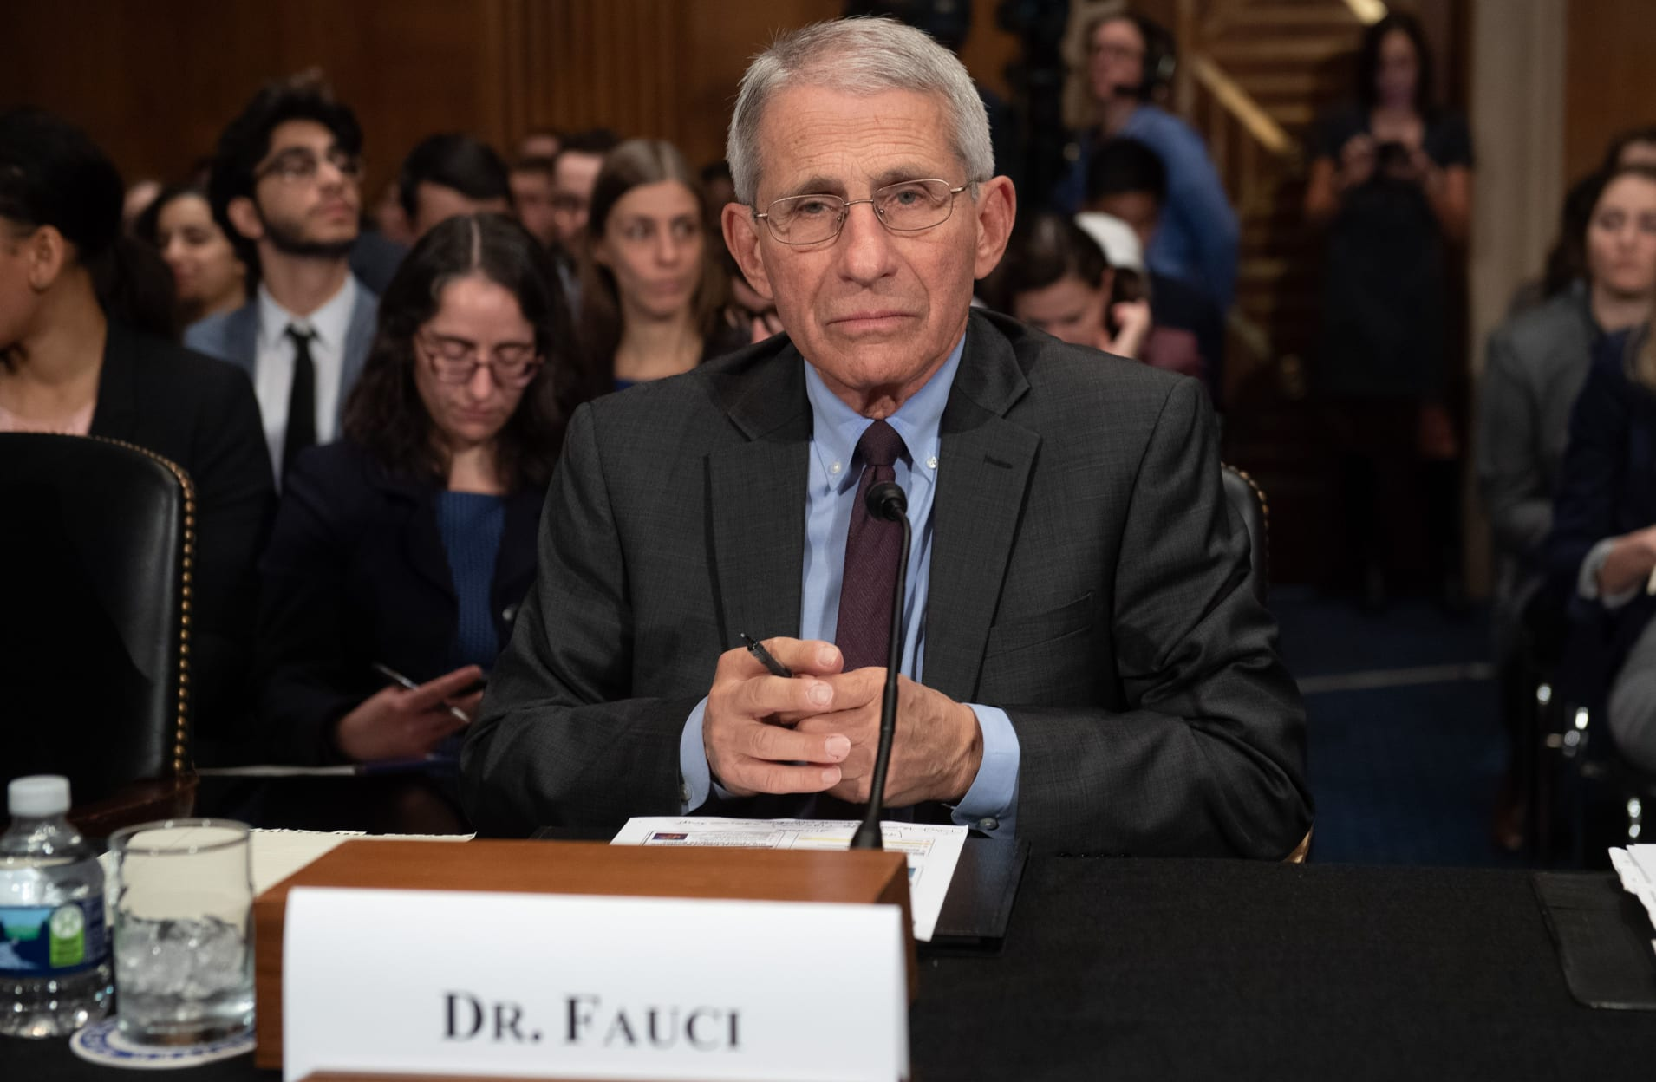
Dr. Anthony Fauci, Director of the NIH National Institute of Allergy and Infectious Diseases testified about COVID-19, during a Senate Committee on March 3.

Slide 5
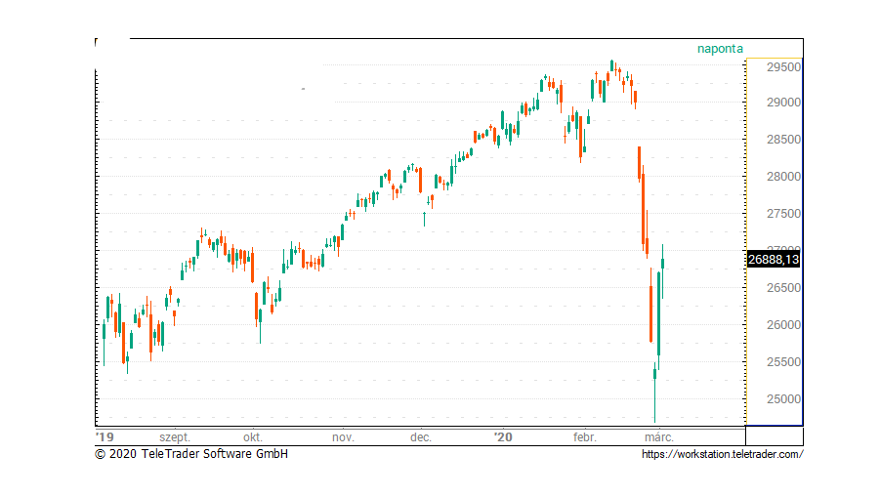
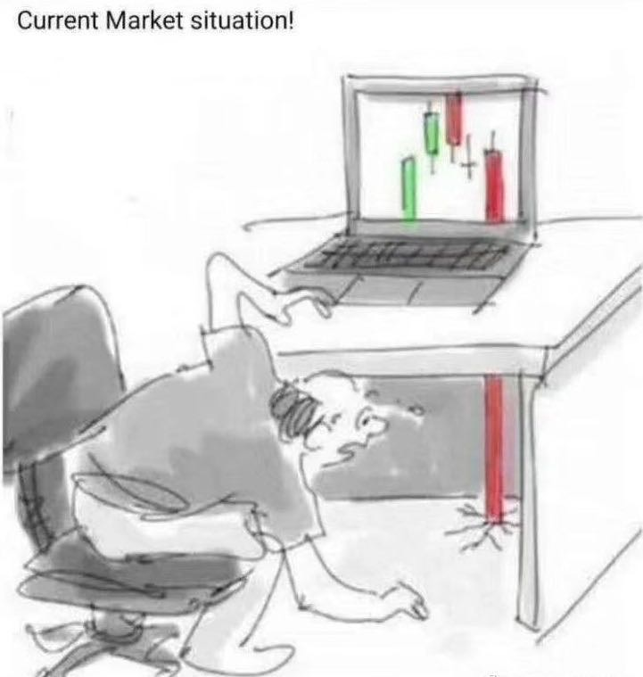
Stock Market

Slide 6
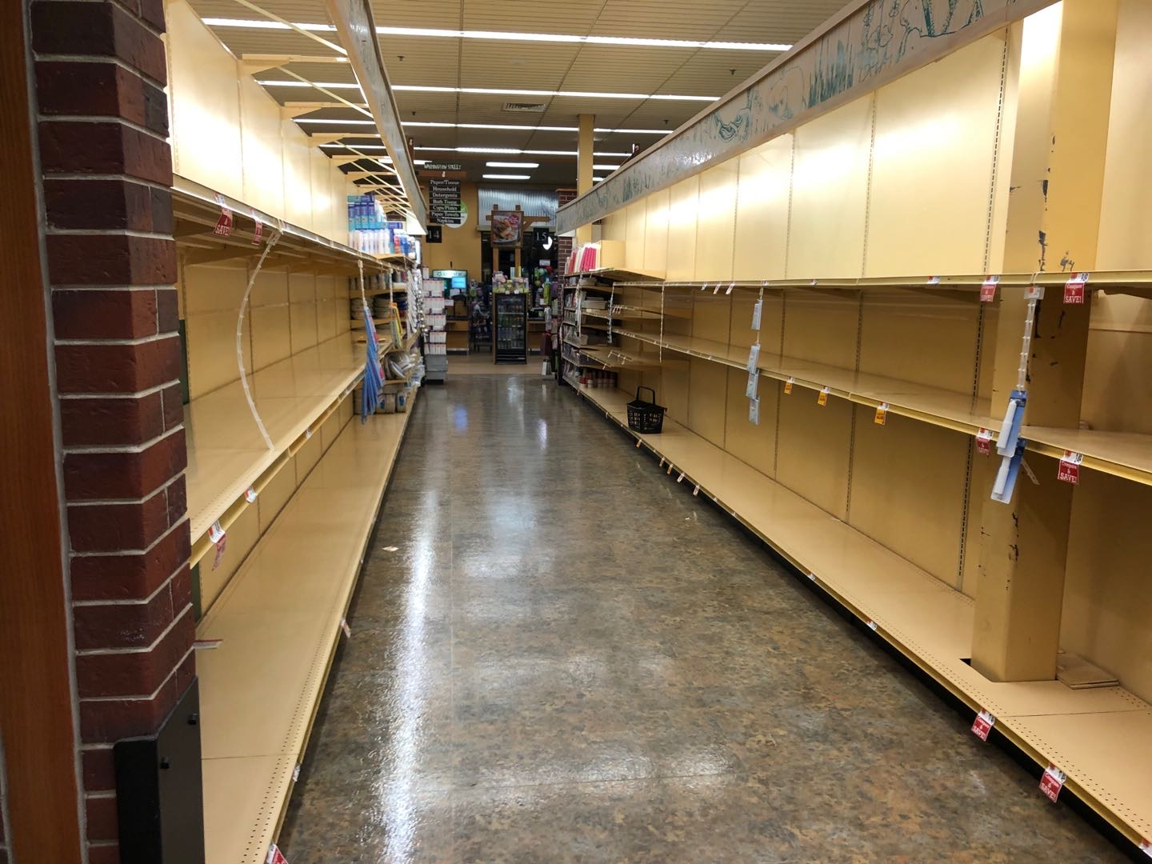
Local Grocery Stores, MA (March 12, 2020)
Roche Brother, Wellesley
BJ, Natick

Slide 7
A lot of public panic right now
I would like to start with a positive message
The Wuhan intervention experience tells us that we can stop the COVID-19 outbreak

Slide 8
Main Goals
What can we learn from the Wuhan experience in controlling for the COVID-19 outbreak?
What worked and what did not work?
Take home messages

Slide 9
The manuscript is on MedRxiv
Wang, et al (2020): Evolving Epidemiology and Impact of Non-pharmaceutical Interventions on the Outbreak of Coronavirus Disease 2019 in Wuhan, China
A summary of the key findings is at my tweet @XihongLin

Slide 10
Acknowledgement
Chaolong Wang, Li Liu, Xingjie Hao, Huan Guo, Qi Wang, Jiao Huang, Na He, Hongjie Yu, An Pan, Sheng Wei, Tangchun Wu
Tongji School of Public Health
Huazhong Science and Technology University
Wuhan
(blue=HSPH alum)
Thank all of my Tongji SPH co-authors for their tireless work on finishing this manuscript in a short time. The gained knowledge benefits US and other countries at this critical time.

Slide 11
Key Point: Wuhan Experience tells us the COVID-19 Outbreak Can Be Controlled by Effective Interventions: Centralized Quarantine
R=1.25
R=0.32
R=3.88
Effective reproductive
number $R_{t}$

Slide 12
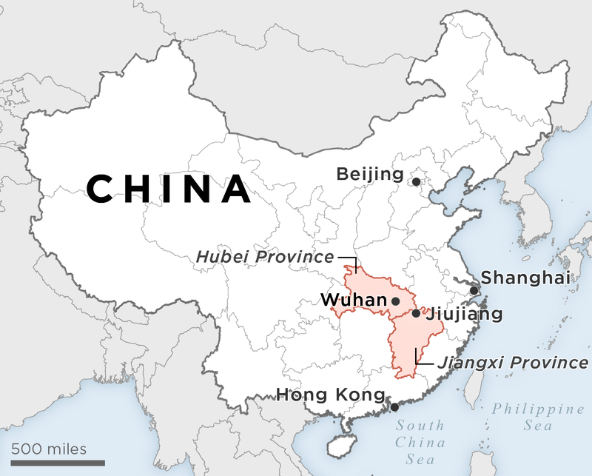
Wuhan
Population size: 11M

Slide 13
Wuhan: A Beautiful City

Slide 14
Wuhan: A Beautiful City
East Lake, Cherry Blossom

Slide 15
Wuhan CDC (n=25,961): December 8 – February 18
Dec 8, 2019: First case: close to the Huanan Seafood Market

Slide 16
Wuhan CDC (n=25,961): December 8 – February 18
Closed on Jan 1, 2020
Dec 8, 2019: First case: close to the Huanan Seafood Market

Slide 17
Wuhan CDC (n=25,961): December 8 – February 18
Dec 8, 2019: First case: close to the Huanan Seafood Market
Jan 11, 2020: Start of Spring Festival Travel

Slide 18
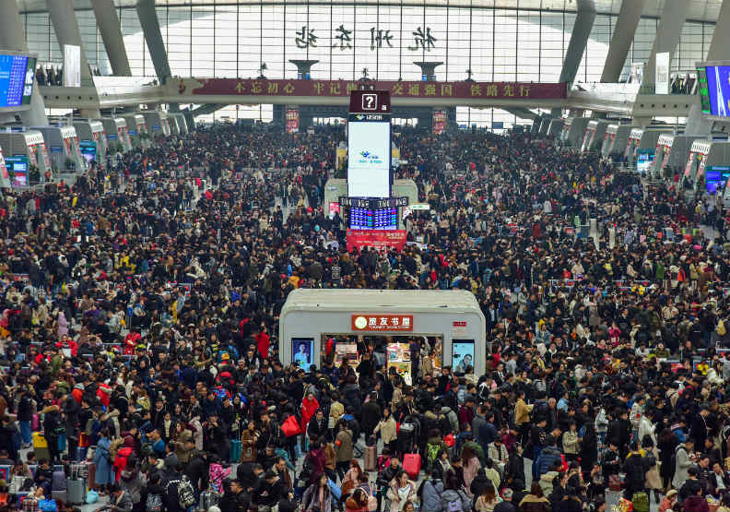
Wuhan CDC (n=25,961): December 8 – February 18
Dec 8, 2019: First case: close to the Huanan Seafood Market
Jan 11, 2020: Start of Spring Festival Travel

Slide 19
Wuhan CDC (n=25,961): December 8 – February 18
Nanshan Zhong
Jan 20, 2020
Nanshan Zhong
Jan 20, 2020
Nanshan Zhong
(Jan 20, 2020)
Confirmed human-to-human transmission
Dec 8, 2019: First case: close to the Huanan Seafood Market
Jan 11, 2020: Start of Spring Festival Travel

Slide 20
Wuhan CDC (n=25,961): December 8 – February 18
Lanjuan Li
Jan 20, 2020
Suggested city lockdown
Dec 8, 2019: First case: close to the Huanan Seafood Market
Jan 11, 2020: Start of Spring Festival Travel

Slide 21
Wuhan CDC (n=25,961): December 8 – February 18
Dec 8, 2019: First case: close to the Huanan Seafood Market
Jan 11, 2020: Start of Spring Festival Travel
Jan 23, 2020 Start of Cordon Sanitaire

Slide 22
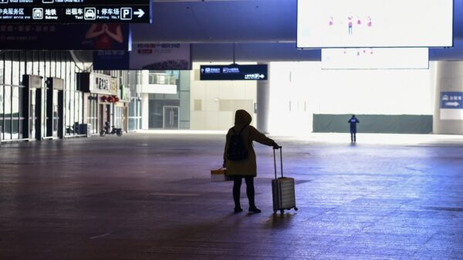
Wuhan CDC (n=25,961): December 8 – February 18
Dec 8, 2019: First case: close to the Huanan Seafood Market
Jan 11, 2020: Start of Spring Festival Travel
Jan 23, 2020 Start of Cordon Sanitaire

Slide 23
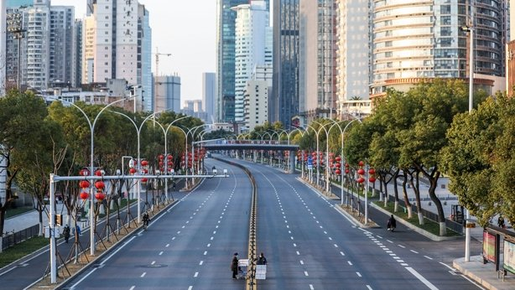
Wuhan CDC (n=25,961): December 8 – February 18
Traffic ban
Dec 8, 2019: First case: close to the Huanan Seafood Market
Jan 11, 2020: Start of Spring Festival Travel
Jan 23, 2020 Start of Cordon Sanitaire

Slide 24
Wuhan CDC (n=25,961): December 8 – February 18
Due to a very large number of cases, the health care system was under an enormous pressure. There was an overwhelming shortage of medical resources, resulting in many patients not being able to receive medical care.
Dec 8, 2019: First case: close to the Huanan Seafood Market
Jan 11, 2020: Start of Spring Festival Travel
Jan 23, 2020 Start of Cordon Sanitaire

Slide 25
Wuhan CDC (n=25,961): December 8 – February 18
To address the serious shortage of medical resources,
Dec 8, 2019: First case: close to the Huanan Seafood Market
Jan 11, 2020: Start of Spring Festival Travel
Feb 2, 2020
Fangchang (Mobile Cabin) Hospitals launched
Jan 23, 2020 Start of Cordon Sanitaire

Slide 26
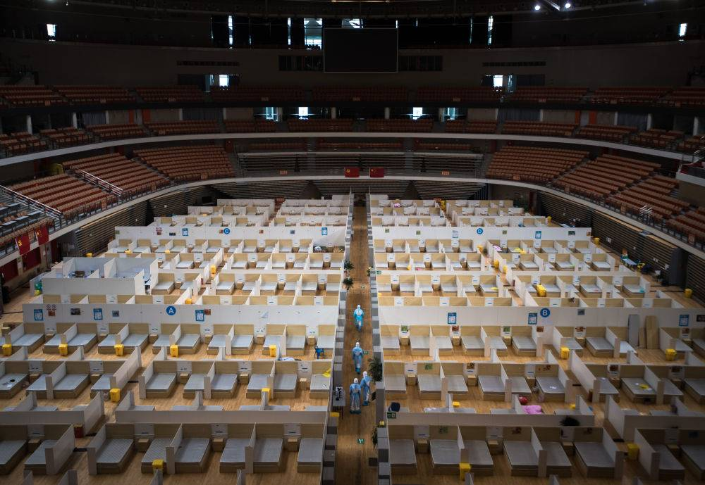
Wuhan CDC (n=25,961): December 8 – February 18
Dec 8, 2019: First case: close to the Huanan Seafood Market
Jan 11, 2020: Start of Spring Festival Travel
Feb 2, 2020
Fangchang (Mobile Cabin) Hospitals launched
Jan 23, 2020 Start of Cordon Sanitaire

Slide 27
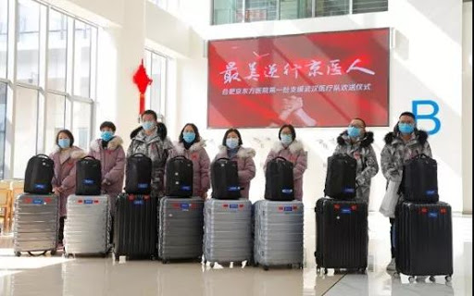
Wuhan CDC (n=25,961): December 8 – February 18
Many healthcare workers across China went to help Wuhan
Dec 8, 2019: First case: close to the Huanan Seafood Market
Jan 11, 2020: Start of Spring Festival Travel
Feb 2, 2020
Fangchang (Mobile Cabin) Hospitals launched
Jan 23, 2020 Start of Cordon Sanitaire

Slide 28
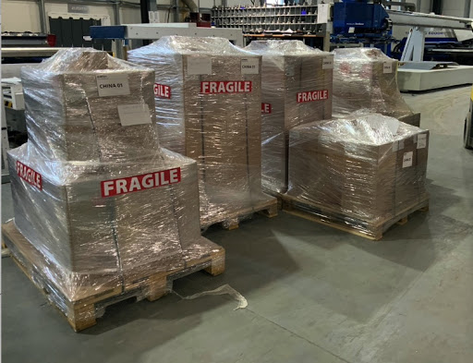
Wuhan CDC (n=25,961): December 8 – February 18
Many donations from China and other countries
Dec 8, 2019: First case: close to the Huanan Seafood Market
Jan 11, 2020: Start of Spring Festival Travel
Feb 2, 2020
Fangchang (Mobile Cabin) Hospitals launched
Jan 23, 2020 Start of Cordon Sanitaire

Slide 29
Illustration of the Extended SEIR Model
S (susceptible), E (latent), I (ascertained infectious),
A (unascertained infectious), H (hospitalized), and R (removed)

Slide 30
Estimated Effective Reproducible Number R
Assume
Incubation period =5.2 days
Infection period=2.3 days
# of unascertained cases =
# of ascertained cases
9 sensitivity analyses

Slide 31
Reported daily COVID-19 infections when there was no intervention before January 23, 2020
Blue = projected trajectory if no prevention had continued
R=3.88
R=3.87

Slide 32
Reported daily COVID-19 infections under lockdown with traffic ban and many quarantined at home between January 23-Feb 1, 2020
Blue = Projected trajectory if this intervention had continued.
R=1.25

Slide 33
Take home message #1: Lockdown with Traffic Ban and Home-Quarantine Helped but was not enough
Family transmission is common.
Infected cases might infect family members and close contacts, who could infect others in the community.
It was challenging for infected cases to seek for medical care due to traffic ban
As it was an honor system, it was difficult to enforce cases to stay at home. Some cases might still go out, grocery shopping, resulting in infecting others.
Traffic ban, mitigation (social distancing) and home quarantine helped reduce R from 3.88 to 1.25, but was not good enough

Slide 34
Boston Case Study (Amy Proal)

Slide 35
Boston Case Study 1 (Amy Proal)
Amy’s case is typical and illustrates the issues with home isolation.
Amy had symptoms on Feb 21, then her boyfriend had symptoms.
Both could not get tested at MGH.
Her boyfriend went to see his internist with no mask (as he could not find one).
If he was infected and went to see doctor by public transportation, he might have infected others but he needed to be helped with transportation.
The internist and the medical staff in the clinic were likely not fully protected and hence were likely to be infected.
He was then told by his doctor to go to CVS to get medicine: He would be likely to infect others at CVS if he was a case, but he needed to get medicine.
If mild cases are not treated early, they are likely to progress and become severe, and are at a much higher risk of death.

Slide 36
Reported daily COVID-19 infections using Centralized Quarantine after Feb 1, 2020
Blue = Projected trajectory if this intervention continues.
R=0.32

Slide 37
Centralized Quarantine Strategies After Feb 1, 2020
Group 1
Group 2
Group 3
Group 4
Close contacts with confirmed or suspected cases
Test positive
Suspected cases
(cases with symptoms)
Have Fever
Mobile Cabin Hospitals
(converted from stadiums or conference centers )
(Mild/moderate cases)
Centrally quarantined in designated hotels
Centrally quarantined in designated hotels
Centrally quarantined in designated hotels
or university dorms
If progressed to be severe
If confirmed case
If confirmed case
Transported to regular hospitals, e.g., ICU
If confirmed case

Slide 38
Measures for Other People During the Centralized Quarantine Period in Wuhan
Continue home-quarantine
Continue general traffic suspension
Provide transportation for groups 1-4 to go to hospitals or designated hotels
Control frequencies of going out, e.g., grocery shopping, for each household, and arrange grocery delivery
Healthcare workers who treat patients stay in hotels or other designated facilities to avoid them from infecting family members and communities, if they are infected
Healthcare workers in contact with cases and exposed subjects are fully protected by PPEs, such as protective suits, medical goggles, caps, face shield, masks and two layers of gloves.

Slide 39
Take home message #2: Centralized Quarantine worked !
Under Centralized Quarantine:
Infected patients, suspected cases and close contacts were less likely to infect others (reduce transmission).
Patients received medical care immediately
Mild cases were treated. This reduced the chance for progressing to be severe cases.
Made case and close contact management and their medical care access easier

Slide 40
Take home message #2: Centralized Quarantine worked!
If a patient progressed to become a severe case in a mobile cabin hospital, he/she was immediately transferred to an ICU in a main hospital.
Reduced the burden on ICU and health care system, which was under an enormous pressure before Feb 1, resulting in many patients without care.
Avoided suspected cases and close contacts from infecting family members and other community members.

Slide 41
Estimated Numbers of Ascertained and Un-ascertained Cases

Slide 42
Take home message #3: A good proportion are community cases: Testing, Testing, Testing
We estimated using the SEIR model that about 60% of infected cases were un-ascertained.
They are often asymptomatic community cases, who could infect others.
This means increasing testing capacity for early diagnosis is critically important.
Current issue in US: Low testing capacity (Need an intermediate multi-pronged strategy)

Slide 43
Wuhan Community Screening Strategy and Testing Priorities
In the Presence of a Shortage of Testing Kits
Suspected Cases
(cases with symptoms)
Priority 1
On Feb 17-19, Community leaders checked every household, door-by-door, for subjects with symptoms, e.g., fever or cough
Priority 1
Taken for testing
If having fever or cough
Priority 3 (not a lot)
Close contacts with cases but without symptoms
Priority 2
Others

Slide 44
Predicted date of zero case in Wuhan (Sum of # of ascertained cases and # of un-ascertained cases)
Early May
95% Creditable Interval (Mid-April to Late May)

Slide 45
Take home message 4: A Multi-pronged Approach is needed
Large scale screening using symptoms (with/without testing kits)
Increase testing capacity
Mitigation (social distancing) and home quarantine
Centralized quarantine for confirmed and suspected cases, symptomatic cases and close contacts (asymptomatic)

Slide 46
Epidemiological Characteristics of 25,000+ Lab-Confirmed COVID-19 Cases

Slide 47
Table 1. The numbers and proportions (%) of the laboratory-confirmed Covid-19 cases stratified by sex and age in Wuhan from December 8, 2019 to February 18, 2020
Characteristics | Before January 11 | January 11-22 | January 23 - February 1 | February 2-18 | Total
Total no. | 637 | 4599 | 12879 | 7846 | 25961
Sex — no. (%)
Male | 334 (52.4) | 2266 (49.3) | 6354 (49.3) | 3952 (50.4) | 12906 (49.7)
Female | 303 (47.6) | 2333 (50.7) | 6525 (50.7) | 3894 (49.6) | 13055 (50.3)
Median age (IQR) - yr | 60.9 (19.4) | 57.1 (21.3) | 57.2 (22.2) | 56.4 (24.5) | 57.0 (22.7)
Age group — no. (%)
0-19 yr | 2 (0.3) | 16 (0.3) | 79 (0.6) | 193 (2.5) | 290 (1.1)
20-39 yr | 71 (11.1) | 820 (17.8) | 2235 (17.4) | 1508 (19.2) | 4634 (17.8)
40-59 yr | 235 (36.9) | 1742 (37.9) | 4929 (38.3) | 2851 (36.3) | 9757 (37.6)
60-79 yr | 287 (45.1) | 1806 (39.3) | 5026 (39.0) | 2826 (36.0) | 9945 (38.3)
≥80 yr | 42 (6.6) | 215 (4.7) | 610 (4.7) | 468 (6.0) | 1335 (5.1)
Healthcare workers — no. (%) | 26 (4.1) | 411 (8.9) | 632 (4.9) | 247 (3.1) | 1316 (5.1)

Slide 48
Attack Rate Per Day By Age

Slide 49
Attack Rate Per Day By Gender and Local Healthcare Workers

Slide 50
Attack Rate Per Day By Children Age

Slide 51
Take home message #5: Protect the Four Vulnerable Groups
Healthcare workers are at a much higher risk of being infected, especially in the absence of protection.
Elderly people are at a much higher risk of being infected.
Family members and close contacts of confirmed and suspected cases and close contacts are at a higher risk of being infected
Children's infection risk is much lower than adults, but the risk increased with time periods.

Slide 52
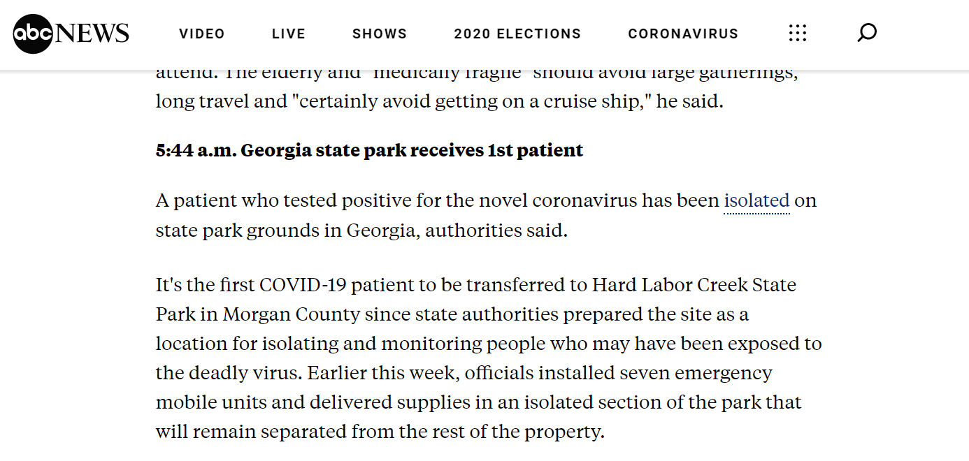
Centralized Quarantine is Happening in the State of Georgia!
March 12, 2020

Slide 53
Centralized Quarantine is Happening in the State of Georgia!
March 12, 2020
The State of Georgia has quarantined the first COVID-19 patient in a state park which has a site with 7 emergency mobile units.

Slide 54
New York Times, March 13, 2020
They were infected before Feb 2 (lack of proper protection). The situation has been much better since Feb 2.

Slide 55
Our healthcare workers do not seem properly protected
No protective suit with hood
No medical goggle
No cap
Infection can be through eyelashes and hair
ABC News: Kirkland Fire and Rescue ambulance workers walk back to a vehicle after a patient was loaded into an ambulance, Tuesday, March 10, 2020, at the Life Care Center in Kirkland, Wash.,

Slide 56
Wuhan’s Strategies for Protecting Healthcare Workers
Full gear: protective suit, medical goggle, cap, face shield, mask and gloves when seeing suspected cases and exposed subjects.
Transmission can be through eyelashes and hair
Developed a stringent protection protocol
Trained healthcare workers how to follow the protection protocol

Slide 57
Wuhan’s Strategies for Protecting Healthcare Workers
Suspected cases, e.g., with symptoms, are seen in designated clinics, instead of ER or PCP offices
COVID-19 hospital level prevention and control management protocol
Patient management protocol
Cleaning and disinfection protocol

Slide 58
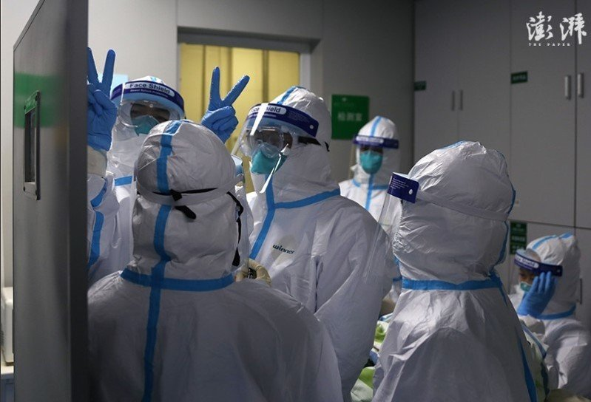
Take home message #5: These Protection Strategies Worked!
None of the 42,000 external healthcare workers who went to help Wuhan has been infected, according to the news on March 12!
0 out of 42,000 infection!
Full protection, stringent protection and management protocol, training

Slide 59
Severity Risk

Slide 60
Relative Risk (RR) of Severe+Critical Status vs Mild+Moderate Status
Characteristics | OR (95% CI) | P value
Age group (years)
20-40 | Ref.
0-10 | 0.334 (0.136 - 0.823) | 0.017
10-20 | 0.637 (0.341 - 1.189) | 0.157
40-60 | 1.437 (1.295 - 1.595) | <0.0001
60-80 | 2.758 (2.490 - 3.054) | <0.0001
≥80 | 5.110 (4.420 - 5.908) | <0.0001
Sex
Male | Ref.
Female | 0.890 (0.837- 0.946) | 0.0002

Slide 61
Relative Risk (RR) of Severe+Critical Status vs Mild+Moderate Status
Outbreak period | Coefficient (CI) | P-value
Period 1 | Ref.
Period 2 | 0.479 (0.397 - 0.577) | <0.0001
Period 3 | 0.249 (0.208- 0.299) | <0.0001
Period 4 | 0.152 (0.126- 0.184) | <0.0001
Occupation
Non-healthcare worker | Ref.
Healthcare worker | 1.120 (0.958- 1.308) | 0.155

Slide 62
Findings on Severity Risk
The risk of severity increases with age, and elderly people are at a statistically significant much higher risk of becoming severe (RR=3 for 60-79 and RR=5 for 80+, p-value<0.0001).
Women have a statistically significant lower risk of becoming severe than men (RR=0.9, p-value=0.002)
Healthcare workers have a statistically insignificant slightly higher risk of becoming severe compared to general public (RR=1.12, p-value=0.16)

Slide 63
Take home message #6: Early Diagnosis and Early Treatment
Early diagnosis and early treatment will help prevent cases from progressing to become severe cases, who have a much higher risk of death, like ARDS patients
Especially for elderly people and healthcare workers.

Slide 64
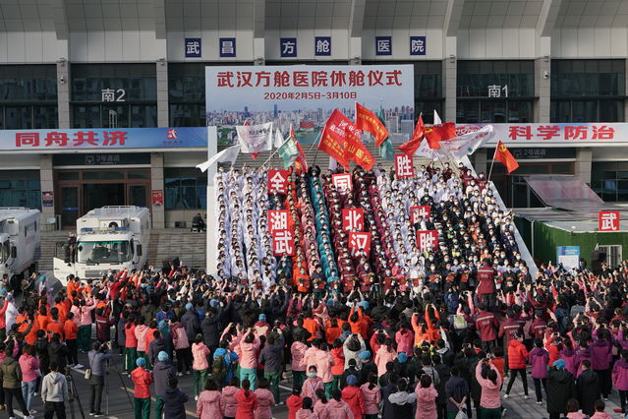
All the 16 Fangchang (Mobile Cabin) Hospitals in Wuhan were closed on March 10, 2020: Cleared All Patients
Closing Celebration
Congratulations, Wuhan!

Slide 65
#s of New and Total Current Suspected Cases: Wuhan, Non-Wuhan and Boston, March 13, 2020
These numbers are from internet, and might not be fully accurate

Slide 66
#s of New and Suspected Cases in Italy, March 12, 2020
These numbers are from internet, and might not be fully accurate

Slide 67
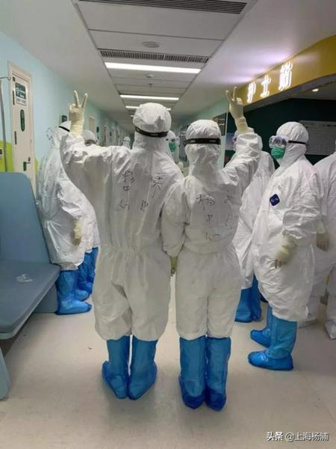
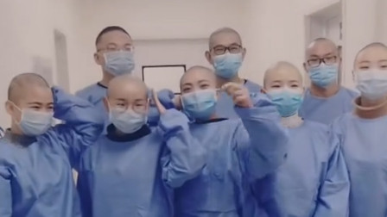
Acknowledgement
Huge thanks go to all the citizens of Wuhan, the local healthcare workers, and the 42,000 healthcare workers cross the country who went to help Wuhan, for their tremendous sacrifice and efforts.
They are my heroes

Slide 68
Concluding Remarks
As we are at the early stage, starting the effective intervention, centralized quarantine of ill patients and exposed subjects, early, will significantly reduce the number of new infections, stop the outbreak, save lives, relieve the enormous pressure on health system, e.g. a lack of ICU capacity.
It will protect our beloved family members from being infected, help patients receive immediate medical care early, reduce community transmission, reduce mortality by preventing progression to severity, which has a much higher risk of death.

Slide 69
Everyone is a team member fighting against COVID-19
Wuhan experience helps us not start from zero.
Find the best strategy suitable for each city and country by learning
from the Wuhan experience
Good policy, strategy and leadership, cooperation are the key!
Song “We are the people”
Go Boston!

